Slide 1
Data Engineering
Arend Valvekens, Mardiros Gundes, Simon Sterckx, Milan Vermeiren, Bram Baestaens, Robin Dewinter

Slide 2
Introduction to Data Mesh
What is data mesh
Concept: introduced (Zhamak Dehghani 2019)
Purpose: Designed to manage complex,large-scale data systems more effectively
Key difference: Shift from a centralized data lakes and warehouses to a decentralized architecture
Approach: Focuses on distributing data responsibilities across domain-specific teams

Slide 3
Why Data Mesh
Traditional Data Architectures:
Centralized control: Data management handled by centralized teams, often distant from data context
Limited: struggle with scalability and flexibility
Often cause bottlenecks and slow response times
Data mesh solution:
Empowers teams closest to data to manage it
Improves agility and scalability
Uses a decentralized, domain-oriented approach

Slide 4
4 principles
domain ownership: - data is owned and managed by the team closest to the business domain, data is relevant and high quality
self-serve data infrastructure platform: - Provides domain teams with self-service tools and infrastructure to manage and access data.
data as a product: - data is treated as a valuable product, with the domain team responsible for delivering reliable,well-documented data
federated governance: - Governance is decentralized yet standardized - Shared policies and automation ensure compliance across domains

Slide 5
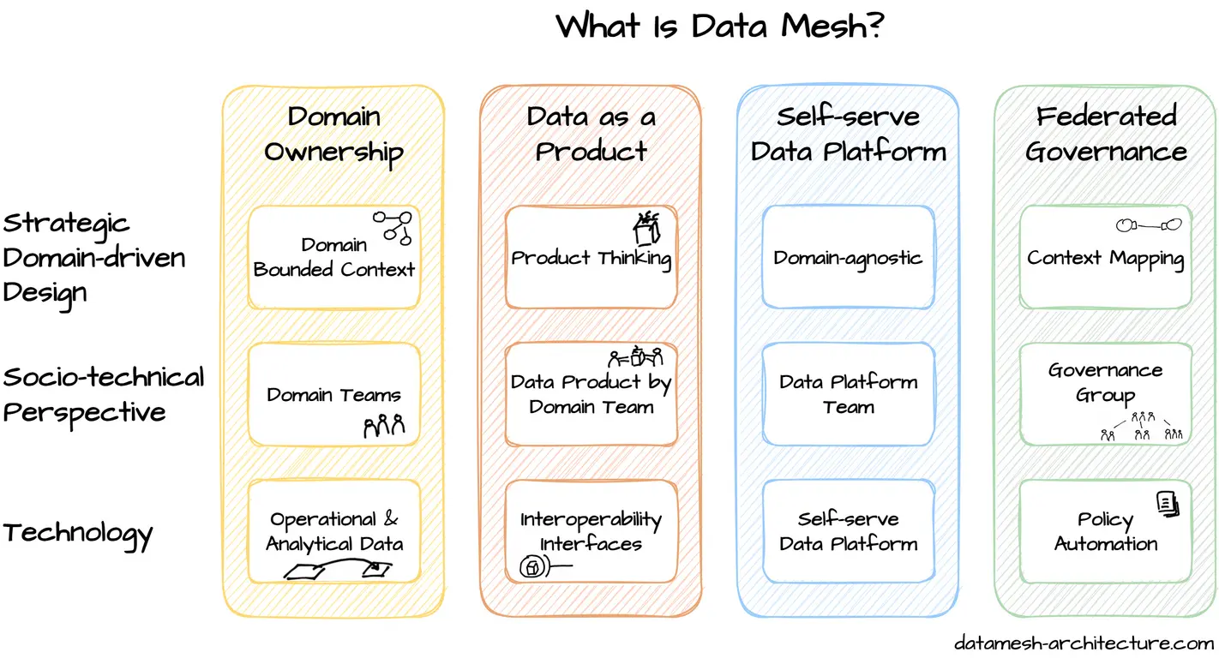

Slide 6
Big Data
Unstructured and structured information
Machines generate petabytes
Things like
Social media posts
Telemetry
Transactions
…
Massive -> generated too fast we can’t keep up
Too valuable to leave unanalyzed
Notes:
unstructured and structured information that humans and machines generate petabytes of data of every day
it’s so massive that data is generated too fast and we cant keep up

Slide 7

Big Data
Large and complex datasets
Contains any sort of data
Reduced storage cost -> big data more common
Extracting value
Notes:
so it refers to extremely large and complex datasets and
can contain any sort of data; any sort of format
due to reduced storage cost it makes big data alot more common in modern times
the goal is to extract valuable information out of this data out of this information

Slide 8

Big Data
Used to be 3 v’s
5 v’s
volume
velocity
variety
veracity
value
Notes:
Volume: Big data requires handling large volumes of low-density, often unstructured data.
Velocity: Data is received and processed at a high rate, sometimes in real time.
Variety: Big data contains diverse, often unstructured data types needing additional processing.
Veracity: Data quality and integrity ensure that insights derived are trustworthy.
Value: Data holds potential value, which must be discovered and applied to drive business benefits.

Slide 9

Evolution of Big data
Past: extreme amounts of data
Hadoop; store, analyze big datasets
Nosql was also popular
Present: new tools
Apache spark -> growth in big data
Future: generative AI and cloud computing
Expand enterprises
Graph databases
Notes:
in the past we already had extreme amounts of data but we also had tools like hadoop to store and analyze big datasets
nosql dbs were also popular
in the present due to new tools like apache spark it caused an explosive growth in big data
in the future the value of data will grow alot because generative AI and cloud computing are being used to expand enterprises
also graph databases are becoming increasingly popular for their ability to display massive amounts of data in a fast and comprehensive way

Slide 10
Apache Spark
Multi language engine for executing data engineering, data science and machine learning
Large scale data processing
Designed to overcome MapReduce
MapReduce limitations
MapReduce is a tool developed by google and popularized by Hadoop
Map: process input data to KV pairs
Reduce: aggregate pairs for a final output
Notes:
it had a few limitations by being optimized for batch processing, making it slow for real time data tasks
because its optimized for handling all data at once
it had two primary functions map and reduce
1 petabyte = 1,048,576 gigabytes (GB)

Slide 11

Apache Spark
RDD (resilient distributed dataset)
Programming abstraction
Read only objects
Split across computing cluster
Can be created from: text files, sql db’s, nosql db’s, HDFS, …
Notes:
the foundation of apache spark is based on RDD
it’s a programming abstraction that represents a collection of read only objects split across a cluster
it can be created from textg files , …
RDDs (Resilient Distributed Datasets) are a core part of Spark's system. They are collections of data that can be processed in parallel across many machines (or nodes) in a cluster.
Resilient means that RDDs can recover from failures. If one machine fails, Spark can rebuild the data on another machine.
Distributed means that the data is split into parts and stored across multiple machines. This setup allows Spark to process large datasets faster by dividing the work among different nodes.
Read-only indicates that once RDDs are created, they cannot be changed. Instead, Spark transforms them to create new RDDs, making it easier to manage and recover data.

Slide 12
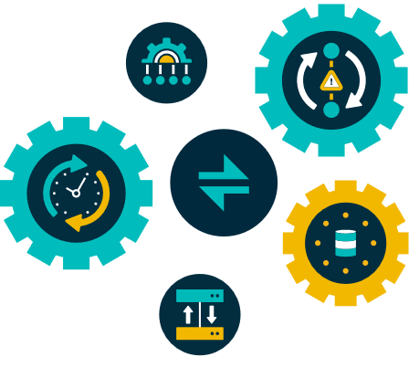
RDD (resilient distributed dataset)
Map reduce functions
Joining datasets
Filtering/ aggregations
Done in memory
Notes:
so RDD has map reduce functions, it can join datasets and filter and aggregate data.
ALl of these operations are done in memory making it incredibly fast.

Slide 13
Spark libraries
Spark SQL for structured data in dataframes
Spark streaming for ingesting small data batches for real time data streams
Mllib machine learning framework
Graphx for graph processing
Notes:
Spark SQL:
Used for handling structured data (data organized in tables or rows and columns).
Works with DataFrames, which are similar to tables in a database, making it easy to query data using SQL-like commands.
Great for tasks like querying, transforming, and analyzing structured data efficiently.
Spark Streaming:
Processes data in real-time by breaking it down into small, manageable batches.
Useful for handling data streams, like incoming logs, user activity, or sensor data.
Allows Spark to handle time-sensitive data, so users get up-to-date results as the data flows in.
MLlib (Machine Learning Library):
A built-in machine learning library for Spark.
Provides tools for building and training machine learning models (such as classification, clustering, and recommendation).
Designed to work with Spark’s distributed computing, which helps scale machine learning tasks across large datasets.
GraphX:
A framework for graph processing and analysis.
Works with data represented as graphs (networks of nodes and edges, like social networks or recommendation systems).
Lets users run algorithms for finding patterns, connections, or relationships within large, complex networks.

Slide 14
Why Apache Spark
Most important feature: speed
Flexible in programmability
Near real time data processing can be handled
Allows for more advanced analytics
Disadvantage
Requires a lot of RAM because it does everything in memory
Advantages of apache spark often outweigh the cost of memory
Notes:
misschien goed om extar te zegge In-Memory Processing:
Spark is designed to load data into memory (RAM) to perform computations very quickly. This avoids the time-consuming disk I/O that traditional systems like Hadoop MapReduce often rely on.
For large datasets, this means Spark needs significant RAM across a cluster of computers, which can add up to a high cost.
Efficient Cluster Management:
Spark doesn't require all the data to be in the memory of one machine. Instead, it distributes the data across many machines in a cluster, each of which handles only a portion of the data.
Companies can rent or set up a Spark cluster to achieve this, and the flexibility to scale up or down as needed can help optimize costs.
Cost-Benefit of In-Memory Processing:
While RAM is expensive, the speed gains Spark offers can reduce processing times from hours to minutes. This often leads to better productivity, faster insights, and reduced operational costs, which can outweigh the upfront memory costs.

Slide 15
Big Data Benefits
better insights
uncover previously hidden connections
expand beyond potentially missed perspectives
decision making
more personalized customer experiences
customer profiles
before -> impossible

Slide 16
Big Data Challenges
organisations struggle to keep up
data needs to be stored and analyzed
2 big challenges
data security
data privacy
technology changing at a rapid pace
Notes:
Organizations face two big challenges as they work with data:
Data Security: Protecting data from unauthorized access and cyber threats is critical, especially as data is stored and processed across various systems. extra: Security breaches can lead to significant financial and reputational damage.
Data Privacy: Ensuring that personal and sensitive data is handled responsibly and complies with privacy regulations (like GDPR) is essential. extra: This involves controlling who has access to data and how it's used, which is increasingly complex as data volumes grow.

Slide 17
Batch Ingestion
Scheduled processing
Collection of data
Example: order from customer
EOD feeds

Slide 18
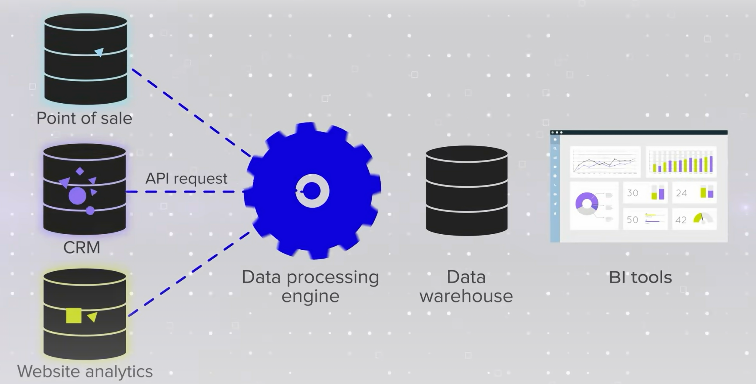
Batch Ingestion

Slide 19
Batch Ingestion Tools
Apache NiFi
Apache Hadoop
Talend
Informatica PowerCenter
AWS Glue

Slide 20
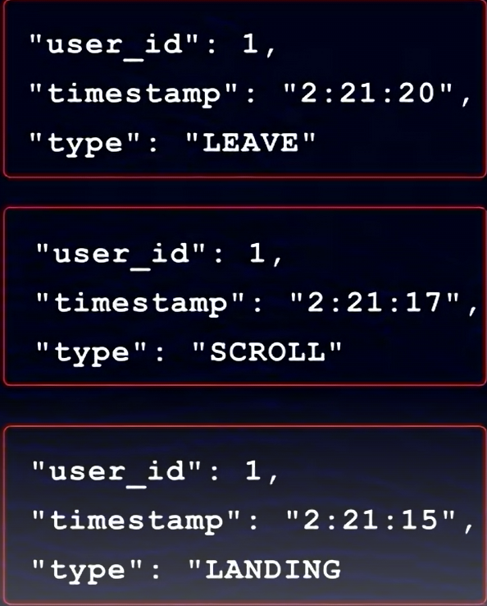
Streaming Ingestion
Real-time processing
Continuous data
Events
Example: analyzing customer behaviour

Slide 21
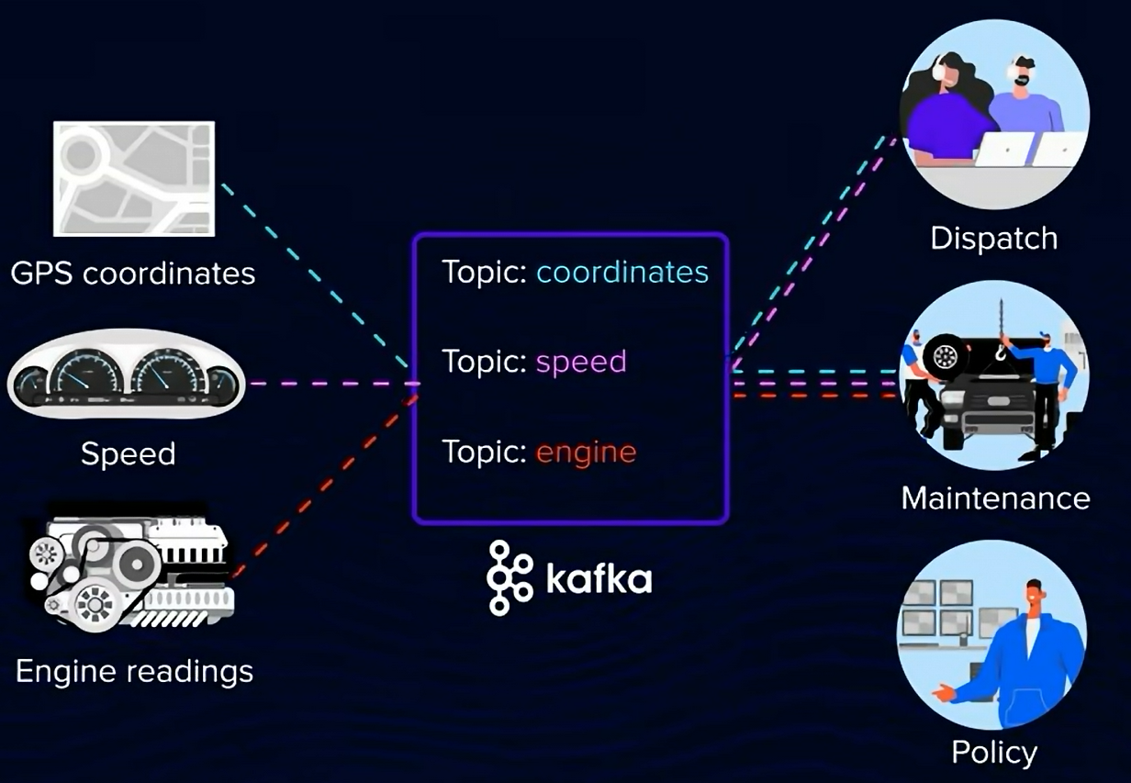
Data Streaming Pipeline

Slide 22
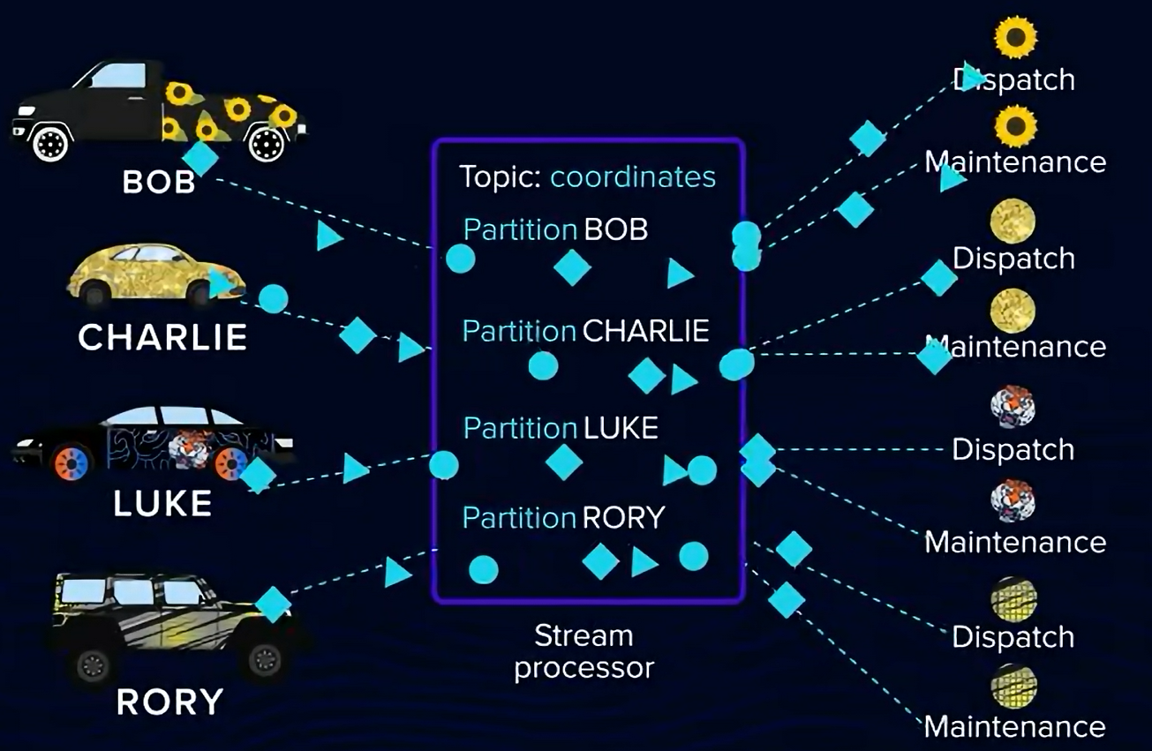
Data Streaming Pipeline

Slide 23
Data Streaming Tools
Apache Kafka
IBM Streaming Analytics
GCP DataFlow
Azure Stream Analytics
Amazon Kinesis

Slide 24

Data Quality
Aspect of data management
Many definitions
“fit for its intended uses in operations, decision making and planning”
Crucial role in decision making

Slide 25
Pillars of data quality
Accuracy:
Accurate representation of real-world values/events
Completeness:
Data that is usable/complete (missing values/info)
Timeliness:
up to date and relevant
Consistency:
No contradictions within a database/system
Uniqueness:
Duplicate data
Relevance:
Aligns with its intended purpose
Notes:
https://www.ibm.com/topics/data-quality
https://www.ibm.com/products/tutorials/6-pillars-of-data-quality-and-how-to-improve-your-data#6pillarsofdataquality
1. Accuracy
Accuracy refers to the extent to which data accurately represents real-world values or events. Ensuring accuracy involves identifying and correcting errors in your dataset, such as incorrect entries or misrepresentations. One way to improve accuracy is by implementing data validation rules, which help prevent inaccurate information from entering your system.
2. Completeness
Completeness concerns whether a dataset contains all necessary records, without missing values or gaps. A complete dataset allows for more comprehensive analysis and decision-making. To improve the completeness, you can use techniques like imputing missing values, merging multiple information sources, or utilizing external reference datasets.
3. Timeliness and currency
Timeliness and currency ensure that your data is up-to-date and relevant when used for analysis or decision-making purposes. Outdated information can lead to incorrect conclusions, so maintaining up-to-date datasets is essential. Techniques like incremental updates, scheduled refreshes, or real-time streaming can help keep datasets current.
4. Consistency
Consistency measures the extent to which data values are coherent and compatible across different datasets or systems. Incorrect data can cause wrong conclusions and confusion among different users who rely on the information to make decisions. To improve consistency, you can implement data standardization techniques, such as using consistent naming conventions, formats, and units of measurement.
For example, the number of employees in a department should not exceed the total number of employees in a company.
5. Uniqueness
Uniqueness refers to the absence of duplicate records in a dataset. Duplicate entries can skew analysis by over-representing specific data points or trends. The primary action taken to improve the uniqueness of a dataset is to identify and remove duplicates. You can use automated deduplication tools to identify and eliminate redundant records from your database.
6. Data granularity and relevance
Data granularity and relevance ensure that your dataset’s level of detail aligns with its intended purpose. Excessive granularity may lead to unnecessary complexity, while insufficient detail might make the data useless for specific analyses. Striking a balance between these two aspects ensures that you have relevant, actionable insights from your data.

Slide 26
Data Quality Management
Set of practices, tools and capabilities
Ensures delivery of accurate and complete data
No standardized approach
Applying the pillars of Data Quality
Not a one-time process, but ongoing

Slide 27
Components of Data Quality Management
Data Profiling
exploring and analyzing data structure, content, types
Data cleansing
removing discrepancies
Data standardization
consistent format across systems
Data validation
setting validation rules for valid data
Data governance
data quality oversight
Automated Data quality and observability
automated tools to monitor and report data quality
Notes:
Data Profiling
Exploring and analyzing data structure, content, and types to understand current data quality and identify anomalies or trends. Data profiling often involves statistics, metadata analysis, and pattern recognition to assess data completeness, uniqueness, and accuracy.
Data Cleansing
Removing discrepancies, errors, and duplicates to improve data quality. This step may also involve correcting data inaccuracies or enriching incomplete data to ensure consistency and accuracy.
Data Standardization
Enforcing a consistent format across systems to unify data, making it easier to integrate and analyze. Standardization often includes formatting dates, names, and numerical values and applying common naming conventions.
Data Validation
Setting validation rules to ensure data meets required criteria before being stored or processed. Validation checks can include data type constraints, range checks, and referential integrity rules to ensure data is reliable and meets business needs.
Data Governance
Establishing policies and practices for data quality oversight and accountability across the organization. Governance frameworks involve data stewardship, defined roles and responsibilities, and compliance with regulatory standards. It sets the foundation for sustainable data quality.
Automated Data Quality and Observability
Using automated tools and dashboards to continuously monitor and report on data quality metrics in real-time. Observability tools track key metrics, detect anomalies, and provide alerts for potential quality issues, enabling proactive management.

Slide 28
Importance of Data Quality
Exponential growth of Big Data
Data management more complex
Data quality management to support analytics
Benefits:
Better business decisions
Improved business processes
Customer satisfaction
Insufficient data quality costs companies 12.9 million/year (Gartner)

Slide 29
Examples of bad data quality
Public Health England’s Unreported COVID-19 Cases
Outdated file format for excel files
XLS instead of XLSX
XLS is only capable of holding 65 000 rows of data
Nearly 16 000 unreported cases

Slide 30
Challenges of data quality (in the Big Data era)
Diversity of data sources
Abundant data types
Complex data structures
Difficult data integration
Large data volume
Global amount of information doubles every 2 years
in 2011 global data created/copied reach 1.8 ZB (64.2 ZB in 2020)
Time consuming
Data changes fast and often
“Timeliness” of data is very short
Real-time data is needed for relevant decision making

Slide 31
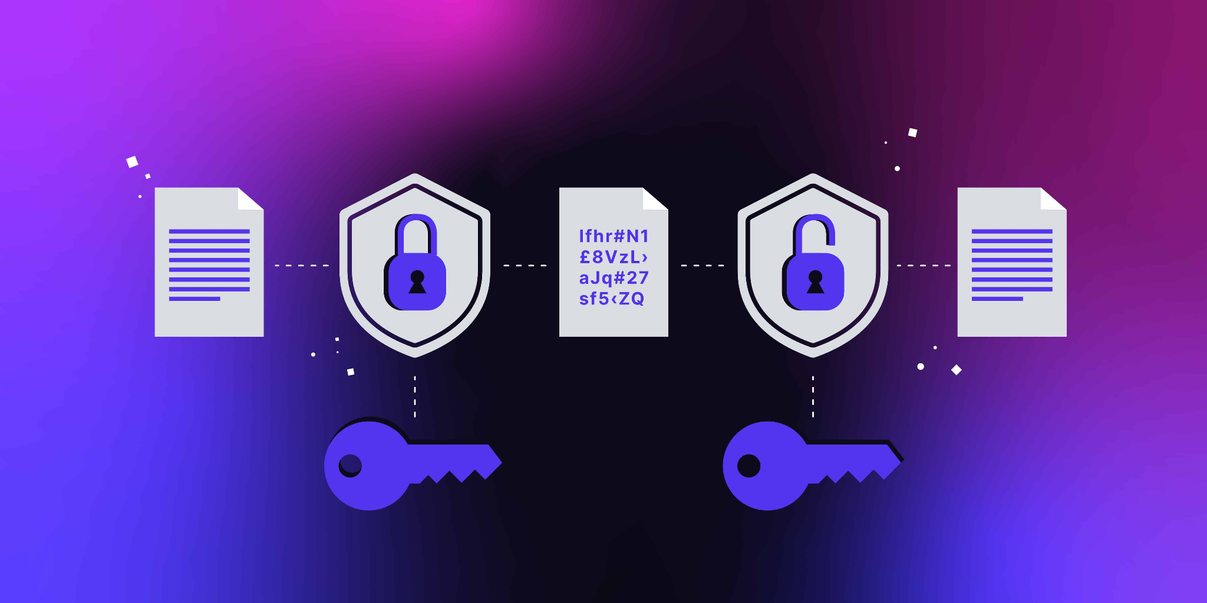
Data encryption

Slide 32
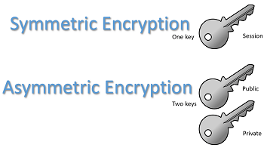
Types of Data Encryption
symmetric encryption (single key)
faster
secure sharing
asymmetric encryption (public and private key)
requires more compute
secure
hybrid encryption
combines both
shares symmetric keys via asymmetric
Notes:
The public key is shared openly and can be used by anyone to encrypt data. However, only the private key (kept secure by the owner) can decrypt the data encrypted with the public key. This setup enables secure communication even when only the public key is shared. For example, if someone wants to send you a secure message, they use your public key to encrypt it. Only you, with your private key, can decrypt and read it. This dual-key system is more secure than symmetric encryption, as the private key never needs to be shared, reducing the risk of interception.

Slide 33
Example of encryption technology
Symmetric Encryption
AES
Blowfish
Asymmetric Encryption
RSA (Rivest-Shamir-Adleman)
ECC (Elliptic Curve Cryptography)
Hybrid Encryption
SSL/TLS (Secure Sockets Layer / Transport Layer Security)
PGP (Pretty Good Privacy)
Notes:
Symmetric Encryption
AES (Advanced Encryption Standard): AES is widely used for securing data across various applications, including file encryption, database protection, and network security protocols. It’s known for its speed and security, supporting key sizes of 128, 192, and 256 bits.
Blowfish: Blowfish is a fast, flexible symmetric encryption algorithm commonly used in software applications for data encryption. While not as secure as AES, it remains popular for its efficiency and adaptability.
Asymmetric Encryption
RSA (Rivest-Shamir-Adleman): RSA is one of the most widely used asymmetric encryption algorithms, commonly used for secure data transmission, especially in SSL/TLS protocols for web communications. It relies on large key sizes (often 2048 bits or more) to ensure security.
ECC (Elliptic Curve Cryptography): ECC is increasingly popular due to its high security with shorter key lengths, making it efficient for mobile devices and low-power environments. It’s used in applications such as secure messaging and digital signatures.
Hybrid Encryption
SSL/TLS (Secure Sockets Layer / Transport Layer Security): SSL/TLS protocols, used in web browsers for HTTPS connections, combine asymmetric encryption (RSA or ECC) to securely exchange a symmetric session key (often AES) used to encrypt the actual data. This approach secures internet communications while balancing performance.
PGP (Pretty Good Privacy): PGP uses a combination of asymmetric and symmetric encryption to protect email communications and files. It encrypts data with a symmetric key, which is then encrypted using the recipient’s public key, allowing for secure and efficient data sharing.

Slide 34
Challenges of Data Encryption
performance
Processing Overhead
Latency in Data Pipelines
Resource Allocation
Scalability Challenges
compliance
Regulatory Requirements
Key Management Policies
Notes:
Performance Impact: Encrypting and decrypting data adds processing time and computational overhead. For large datasets, especially in real-time data engineering pipelines, encryption can slow down processing. Symmetric encryption is faster and typically less resource-intensive than asymmetric encryption, but both add latency. Engineers have to balance data security with acceptable performance.
Scalability Issues: Scaling encrypted systems can be complex, especially if encryption and decryption require a lot of computational power. As data volume grows, the resource demands for handling encryption operations increase. Asymmetric encryption’s higher computational cost makes it particularly challenging for large-scale applications.
Compatibility Concerns: Different systems and applications may use varying encryption standards or data formats, which can lead to compatibility issues. For example, one system may require AES encryption, while another only supports RSA. Compatibility can be especially problematic in legacy systems that may not support newer encryption algorithms. Compliance and Regulatory Requirements: Different regions and industries have specific regulations around data security, such as GDPR in Europe or HIPAA in healthcare. These regulations dictate not only the use of encryption but also key management practices, access control, and audit requirements. Data engineers must ensure that encryption practices align with these regulations, which can add complexity to implementation and maintenance.

Slide 35
AI and Data Engineering
Generative AI
Key points:
How does AI create more data and the associated challenges
The role of data engineers in leveraging this data
How AI helps evolve data from just ‘more’ to better data
Importance of data observability in managing this transformation

Slide 36
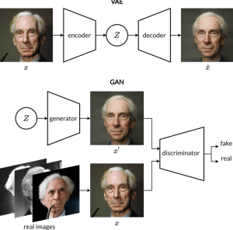
More Data–AI’s Contribution
Synthetic Data
GANs and VAEs generate synthetic datasets, filling gaps in existing data and enabling better testing and modeling
Enhance quality and scale of machine learning models

Slide 37
Challenges
Diverging from True Patterns
Data Observability to Ensure Data Reliability
Monitor, Verify and Integrate

Slide 38
AI and the Evolution of Data
Improving Access to Data
Helps Data Integration
Data Democratization: Self-Service Analytics with Natural Language Queries

Slide 39
Conclusion–AI and Data Engineering’s Future Together
AI Enhances the Role of Data Engineers
Quality, Reliability and Integration of AI-generated data
Collaboration is essential to capitalize on AI’s capabilities

Slide 40
sources
https://www.oracle.com/big-data/what-is-big-data
https://www.youtube.com/watch?v=ymtq8yjmD9I
https://www.youtube.com/watch?v=ag9jlVxM_18
https://www.youtube.com/watch?v=A3Mvy8WMk04
https://www.precisely.com/blog/big-data/streaming-data-pipelines-how-to-build-one
https://www.acceldata.io/blog/impact-of-ai-on-data-engineering

Slide 41
Data Quality Sources:
https://www.ibm.com/products/tutorials/6-pillars-of-data-quality-and-how-to-improve-your-data#6pillarsofdataquality
https://www.ibm.com/topics/data-quality

Slide 42
Data encryption resources
https://www.linkedin.com/advice/0/what-most-effective-data-encryption-decryption

